Slide 1
A Danger-Aware A* Agent for CoinTex
COMP6009 Assignment Part A
Colombo-group-08: Pavithra Solomons (24079123), Ravindu Chandrasekara (24100201), Rashmika Dilshan (20543909)

Slide 2
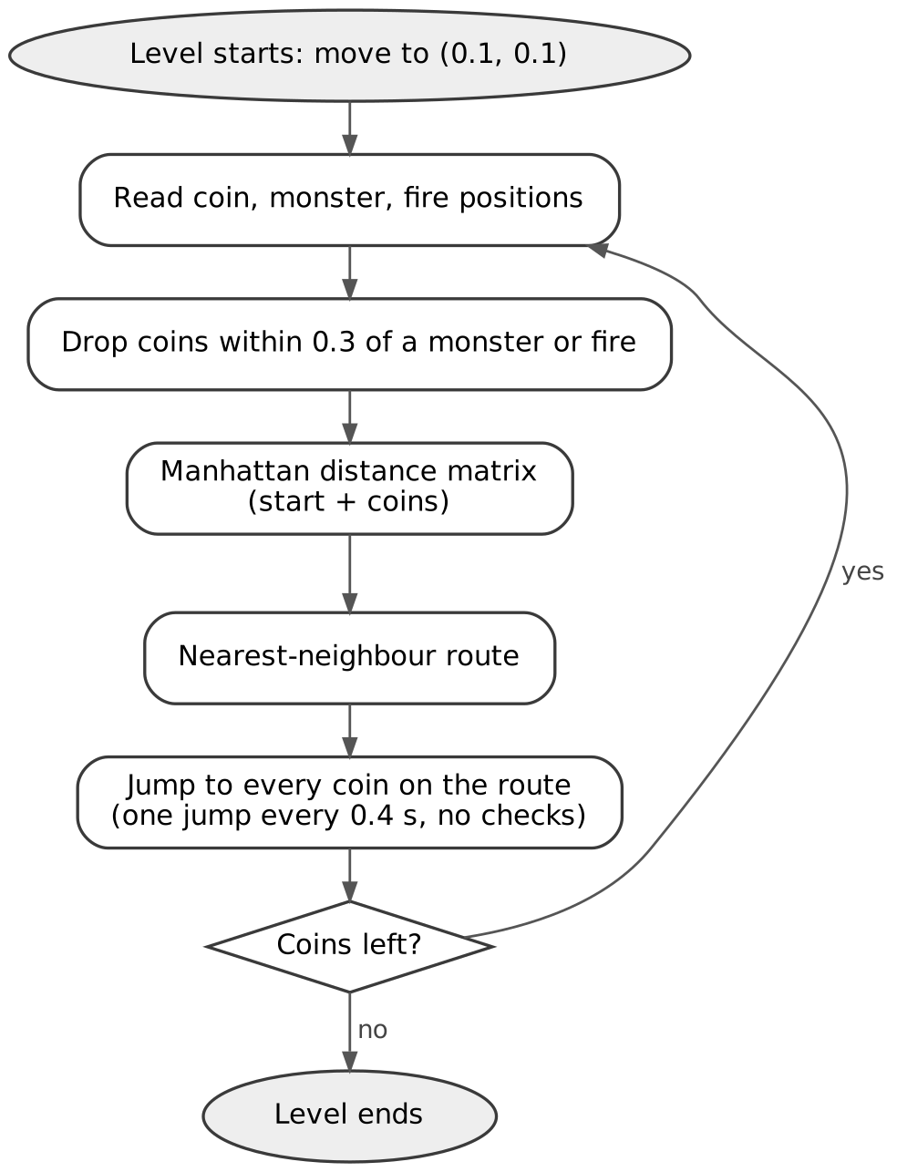
The greedy agent plays with its eyes closed
Original agent in main_work_greedy.py
Problem | What happens in the game
Hazards only checked when planning | Jumps between coins can go straight through a monster or fire
Plan made once per route | Monsters keep moving for the whole route (0.4 s per coin)
Start point never updated | Every new plan starts from (0.1, 0.1), not the character
Coin filter bug | Deletes from the list it loops over; the wrong coins get dropped
Thread never stops | After a death two agents drive the next level
Result in the real game: 96 of 120 runs won (80.0%), 24 deaths, 59.3% life left on average.

Slide 3
Two facts about the game shaped our design
From main_work_greedy.py and cointex.kv
0.25 s
20-35
per jump, whatever the distance
frames of contact before the character dies
Time to clear a level depends on the number of jumps, not the distance travelled
Shortening the route, which is what greedy optimises, saves no time
Long jumps are fine as long as nothing is in the way
One life point is lost for every frame touching a monster or fire
At 60 fps that is about a third to half a second of contact
So the agent must know when it will be near a hazard, as well as where
Hit boxes from cointex.kv: monster within 0.075 of the character's centre, fire within 0.05. Coins are collected within 0.05.

Slide 4
Our agent re-plans every jump with A*
A* from Lecture 3: f(n) = g(n) + h(n)
1 Sense
2 Predict
3 Danger map
4 A* search
5 Safe jump
Positions of the character, coins, monsters and fires; hazard speeds from the last snapshot
Monsters keep their speed, with a margin that grows with time; fires bounce along their path
40 × 40 grid over the screen: very costly inside a predicted hit box, less so nearby
Cheapest path to any coin; step cost = length × (1 + 8 × danger)
Longest straight jump that is clear at the moment the character passes
Choosing the jump in step 5
Coin reachable safely
Coin not safe, path is
Nothing safe
Jump straight to the coin
Jump to the farthest safe point on the A* path
Escape to the nearby point (or stay) with the most clearance
Repeat every 0.25 s, from wherever the character actually is, until no coins are left

Slide 5
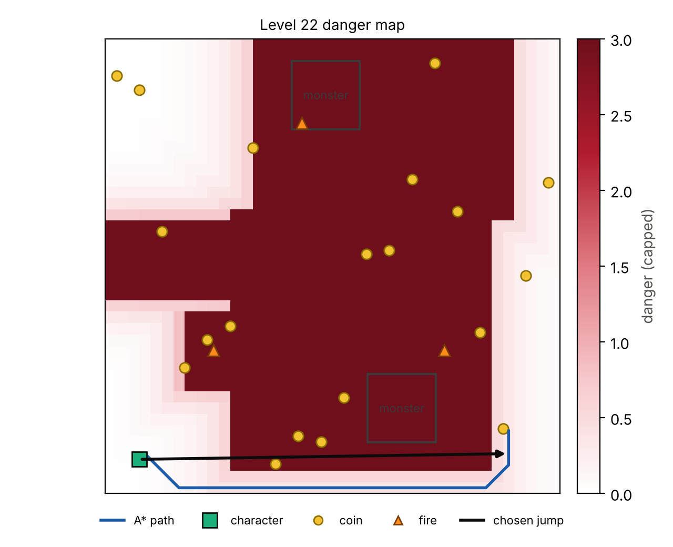
How danger gets into the search
Level 22 danger map
Dark red cells are where a hazard is predicted to be at some point in the next 0.6 s
A* goes around them (blue line)
The chosen jump (black arrow) cuts the corner: each point on the line is checked against where the hazards will be at the moment the character passes, not where they are now
If nothing is safe, the agent tries 64 nearby points and staying still, and takes the one with most clearance

Slide 6
What is new compared with the greedy agent
Greedy agent vs A* agent
 | Original greedy | Our A* agent
Choosing a coin | Nearest by Manhattan distance, whole route fixed | Cheapest path once danger is counted, chosen again every jump
Monsters and fires | Only skip coins within 0.3 when planning | Predicted 0.6 s ahead and built into every cell's cost
Moving | Straight jumps with no checks | Only jumps that are clear when the character passes
Re-planning | After the whole route | Every 0.25 s
Planning starts from | Always (0.1, 0.1) | The character's real position
In danger | No reaction | Escape move with the most clearance
Search | Nearest-neighbour heuristic | Multi-goal A* with a guess that never overestimates
To keep the test fair, the greedy logic is copied unchanged and every agent moves through the game's own start_char_animation.

Slide 7
Results: 360 games in the real game
3 agents × 24 levels × 5 runs
120/120
96/120
99/120
games won by A*
games won by greedy
games won by the GA
 | Greedy | GA | A* (ours)
Levels completed (3+ wins of 5) | 21 / 24 | 21 / 24 | 24 / 24
Mean time to collect all coins, 24 levels (s) | 5.67 | 12.25 | 4.60
Life left (%) | 59.3 | 57.2 | 99.7
Deaths | 24 | 21 | 0
RACR: coins per second × life left | 1.48 | 0.81 | 3.10
RACR is our extra metric: it rewards being fast and unhurt in one number, and still gives credit for coins collected before a death.

Slide 8
Level by level
Success rate by level
Greedy did worst on levels 18, 23 and 24 and the GA on levels 18, 21 and 24. All their losses were deaths. A* won 120 of 120 games.

Slide 9
Faster as well as safer
Mean completion time by level
A* averaged 4.60 s over all 24 levels
Greedy 5.67 s, GA 12.25 s
A* was faster than greedy on 22 of 24 levels
Part of this is rhythm: A* moves every 0.25 s, the original greedy waits 0.4 s per jump

Slide 10
Limitations and what we would do next
Proposed, not implemented
Idea | Why it should help
Hybrid GA + A* | GA evolves the order of the coins (a permutation); A* plans each safe leg and its path costs become the GA's fitness. Fixes stranded coins on 18-25 coin levels
GA to tune A* | Our danger weight, margins and look-ahead were set by hand; a GA could search them per level type
Markov model of monsters | Lecture 8: a belief over where each monster is heading, updated every frame, gives hit probabilities per cell
Expectimax look-ahead | Lecture 6: monsters are random, not adversaries, so plan for the average case over the next few jumps
Limitations: one laptop, 5 runs per level (a level's rate moves in 20% steps), A* settings tuned in our simulator, and the GA is the tutorial GA, not one tuned for this game.

